Slide 1


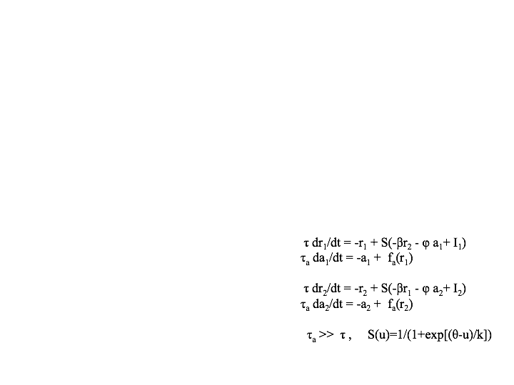
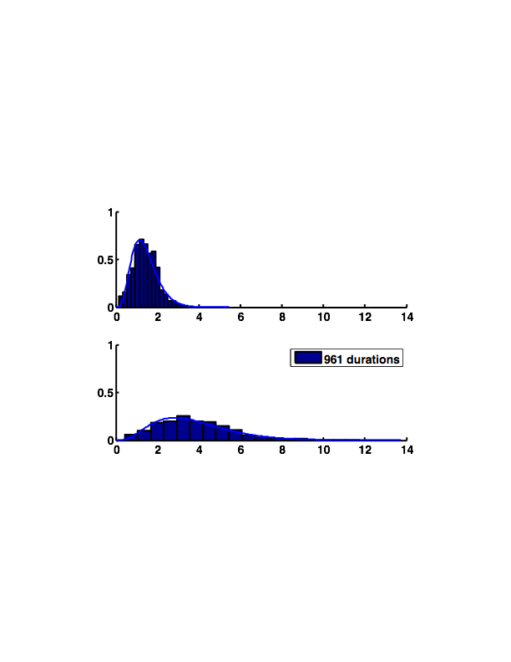
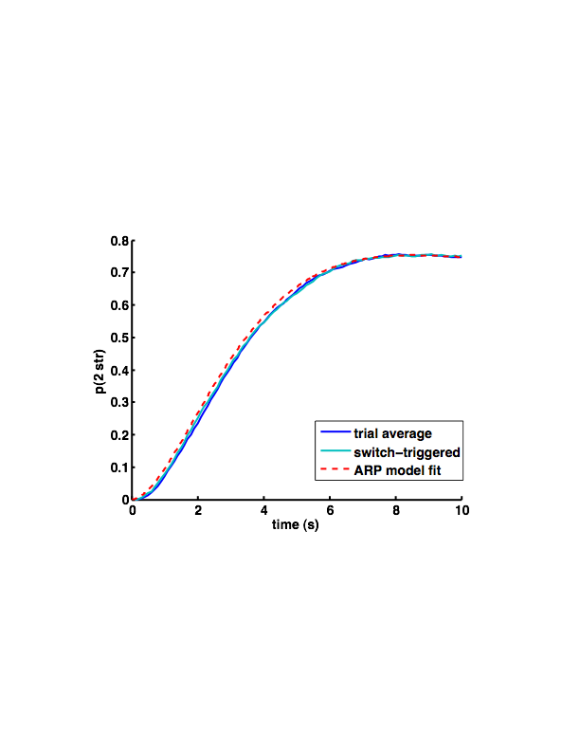
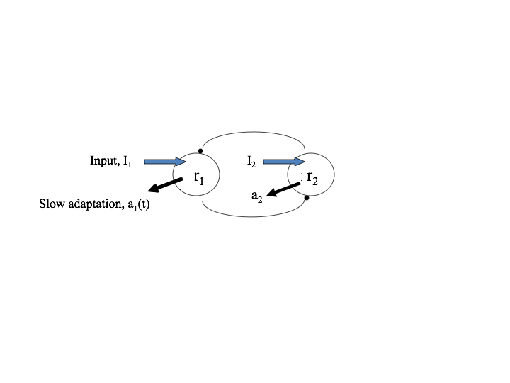
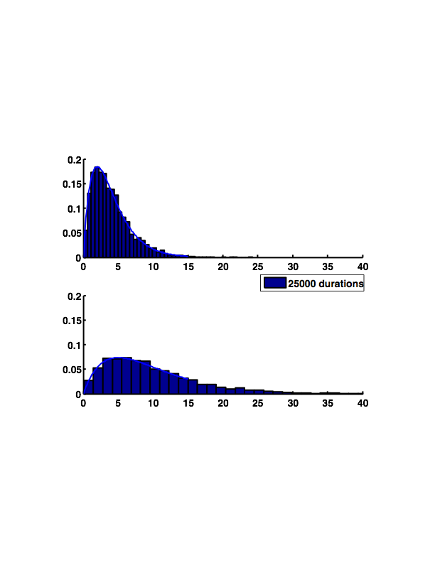
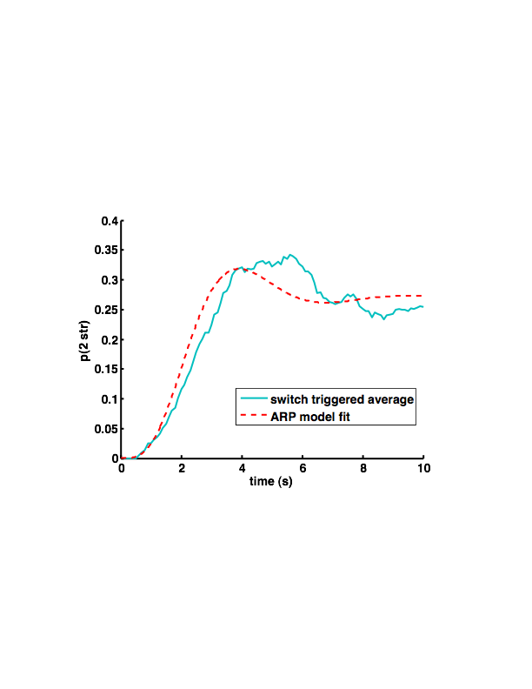
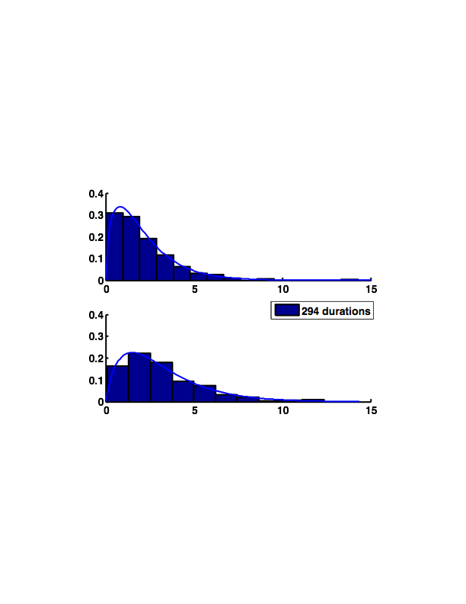
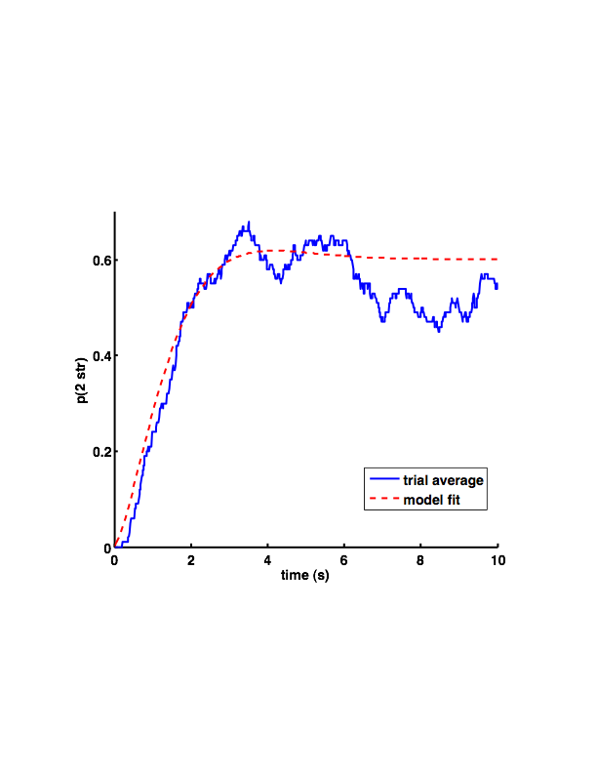
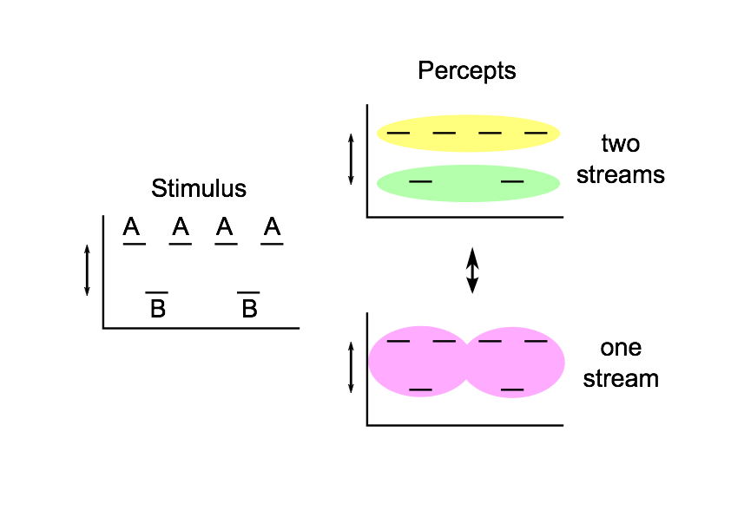
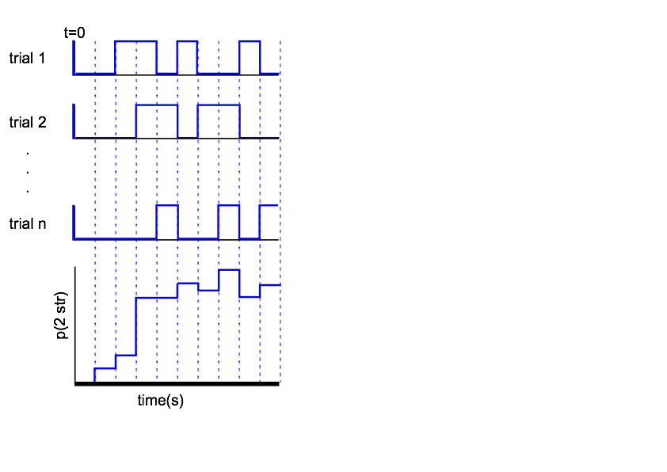
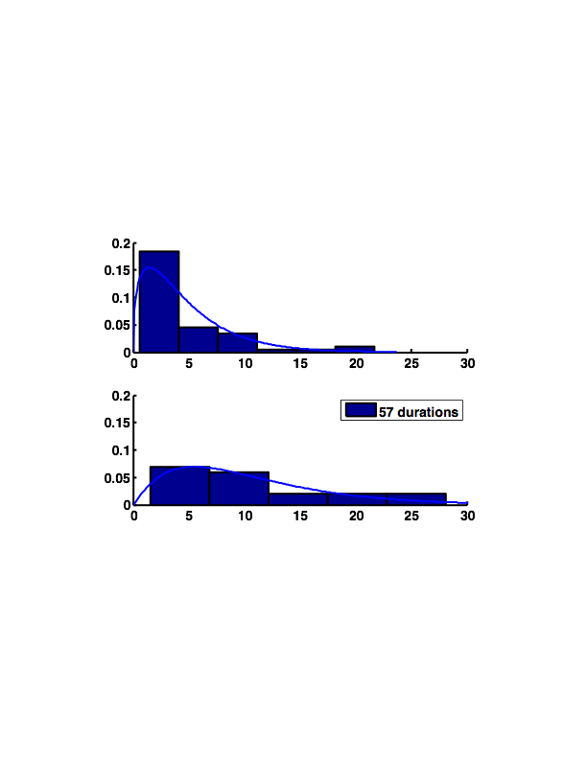
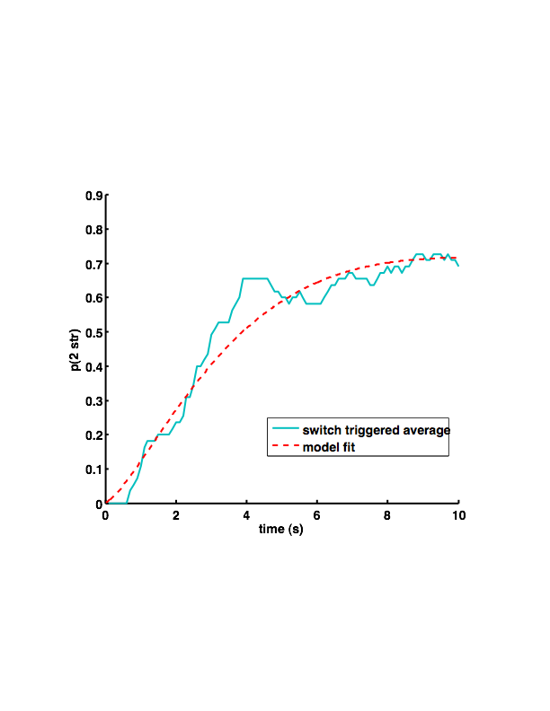
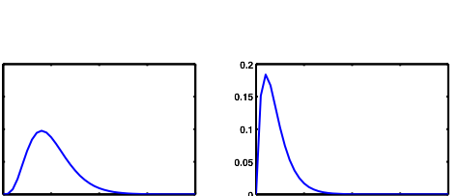
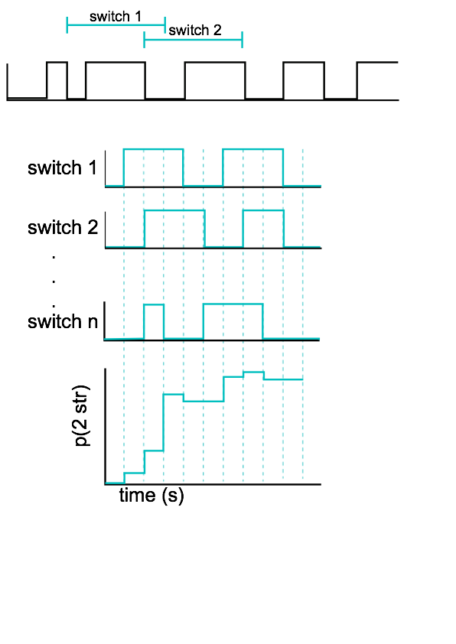
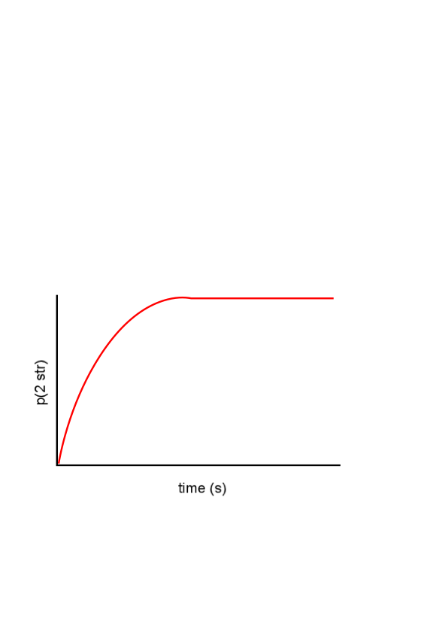
A statistical dynamic model for buildup of stream
segregation with an ambiguous ABA auditory stimulus
Sara Steele¹, Daniel Tranchina^{2,3}, John Rinzel^{1,2}
¹Center for Neural Science, ²Courant Institute of Mathematical Sciences, ³Department of Biology
New York University, New York, NY
steeles@cns.nyu.edu
Introduction
When ABA tone sequences are ambiguous (van Noorden, 1975) the probability of perceiving the sounds as segregated into two streams builds up over time (Micheyl et al, 2005; Pressnitzer et al, 2008). During long trials listeners report spontaneous alternations between hearing one or two streams - the percept is bistable (Pressnitzer & Hupe, 2006). We demonstrate that the probability time course, the buildup function (BUF), can be described by a statistical model with dominance durations drawn randomly from two independent distributions for 1 or 2 stream dwell times. Our model contrasts with interpretations that the BUF reflects an accumulation of sensory evidence supporting the existence of multiple sound sources (Bregman, 1990), or as an accumulation of adaptation (Micheyl et al, 2005). We apply the model in predicting the BUFs for preliminary behavioral data and for alternations generated by a competition model for perceptual bistability.
Methodology
1. Alternating draws from gamma distributed durations generate buildup functions
3. Buildup functions from dynamical competition models fit by alternating renewal process
4. Conclusions
Buildup functions are predictable based on a statistical dynamic model: alternating durations from gamma distributions (ARP: alternating renewal process)
Buildup functions are obtained from short trials, or equivalently (assumption), by switch triggered averaging from long trials.
Model assumes independent gamma distributions of durations, but is robust to data with some correlation between durations from percept to percept
ARP model demonstrates that buildup does not require accumulation (of evidence or adaptation)
From short trial buildup functions, we expect to be able to predict the distributions of percept durations that will be obtained in long trials
Acknowledgments
JR supported in part by NIH: DC011602
Acknowledgments
from simulations: short trials (ensemble average), long trials (switch triggered)
from theory, analytic: alternating renewal process (ARP)
1 stream
k=5.21
θ=0.27
k=5.21
θ=0.27
1 stream
k=2
θ=2
2 streams
k=4.02
θ=0.94
p(percept duration)
k=4.02
θ=0.94
2 streams
k=2
θ=5
r = .29
2. Buildup functions from psychophysics modeled as alternating renewal process
Short trials
Long trials
Wilson & Cowan, 2003; for specific parameters, see Shpiro et al, 2009
2. Compute buildup
functions- two methods
Estimated parameters of two gamma distributed percept durations (one or two streams), by maximum likelihood
Predicted buildup functions fit data well, in spite of correlations (r values) between successive percepts
1. Paradigm
One subject completed 100 trials of 10 s each, a second subject completed 3 trials of 4 minutes each
1. Short trial:
ensemble averaging
2 str
1str
frequency difference
1 stream
k=1.60
θ=1.34
tone duration: 125 ms
5 semitone difference
p(percept duration)
r = .04
2 streams
k=1.86
θ=1.74
3. Predicting BUF from two independent gamma distributions
2. Long trial:
switch-triggered average
subject 1
94 trials
Distribution of percept durations
“1 stream”
“2 streams”
1 stream
k=1.45
θ=3.26
p(duration=x)
k1 (shape)
θ1 (scale)
k2
θ2
duration (s)
p(percept duration)
r = .29
Alternating renewal process model (ARP)
2 streams
k=2.08
θ=5.12
p(2 str|t) =
f(k1,θ2,k2,θ2
subject 2
55 averaging windows

